Slide 1
Predicting Customer Satisfaction in the Airline Industry
Team 6 – Joshua Farina (joshuapfarina), Henri Salomon (henri_salomon), Raajitha Middi (Raajitha_Middi), Ryan Chandler (zujin87), Alejandro Martinez (amzeta)
Notes:
Mention my name

Slide 2
Problem Definition and Benefits
We intend to use airline passenger satisfaction survey data to determine which factors drive customer satisfaction (or dissatisfaction) so that we can provide actionable recommendations on how money should be invested or re-allocated to keep passengers satisfied.
Customer satisfaction is a key factor in attracting and retaining business. Identifying factors that have the strongest effect on customer satisfaction will provide key insights for airlines to enhance their services, improve the customer experience and optimize business operations.
Some estimates indicate that increasing customer retention by as little as 5% increases profits by 25%-95%.¹

Slide 3
Dataset Overview
The dataset is taken from surveys from a US airline. It includes user ratings for multiple aspects of air travel such as food and drink and seat comfort, as well as customer information such as age and gender.²
Notes:
Mention that satisfaction is the target value.

Slide 4
Dataset Overview
The dataset is taken from surveys from a US airline. It includes user ratings for multiple aspects of air travel such as food and drink and seat comfort, as well as customer information such as age and gender.²

Slide 5
Dataset Overview
The dataset is taken from surveys from a US airline. It includes user ratings for multiple aspects of air travel such as food and drink and seat comfort, as well as customer information such as age and gender.²
Highly correlated
Notes:
Getting rid of arrival time because it is highly correlated and has a lot of NA values.

Slide 6
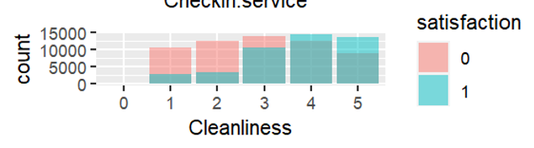
Progress and Challenges
Data cleaning status
Missing values removed
Investigating values with a Z-score > 3
Manually one-hot encoding data to establish baselines
Initial findings
Flight distance is not statistically significant
Business class is more likely to be satisfied
Some ratings seem irrelevant to customer satisfaction
Will not be able to merge flight path data to try to infer airport locations due to insufficient information:
Main dataset does not specify number of legs in a trip
Flight distances in main dataset are too similar in many instances which would make it impossible to narrow down with any certainty which airports were involved in the trip
Understanding how to map a binary satisfaction variable to a Likert scale variable
Notes:
Data is pretty clean. Flight distance according to linear regression

Slide 7
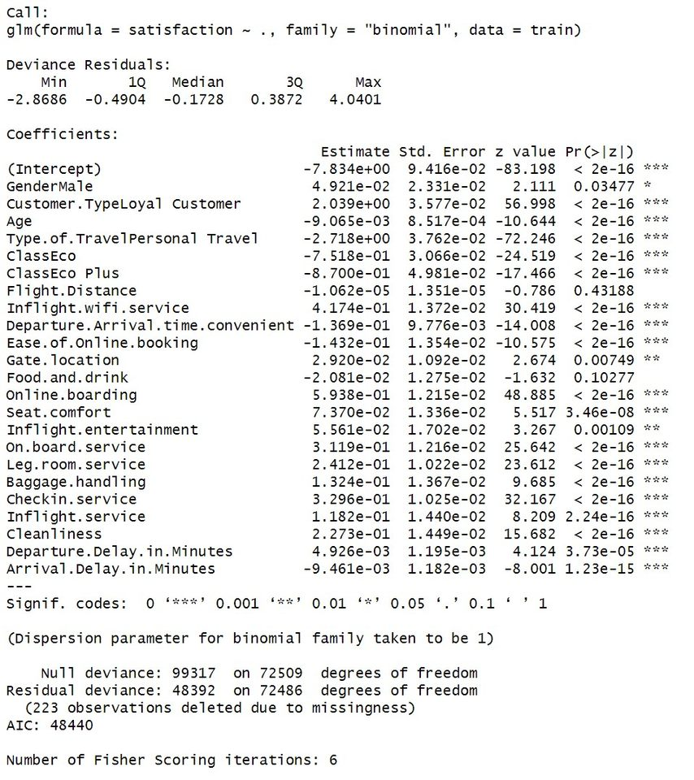
Modelling: First Pass Logistic Regression
Notes:
No transformations done, initial pass.
We thought that Flight Distance and Food and Drink would both be important.

Slide 8
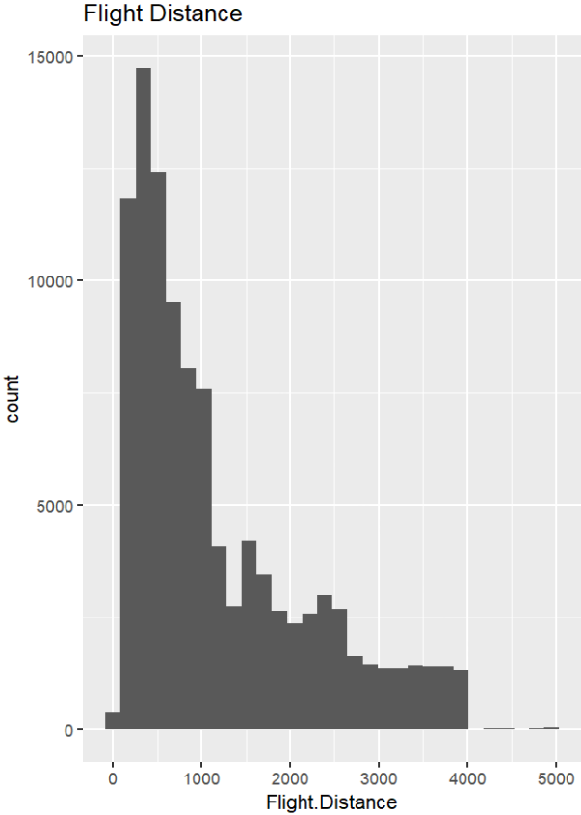
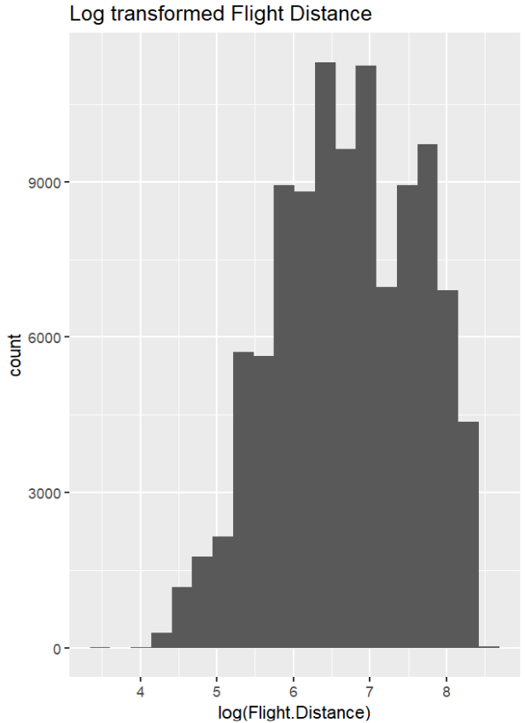
Transformations

Slide 9
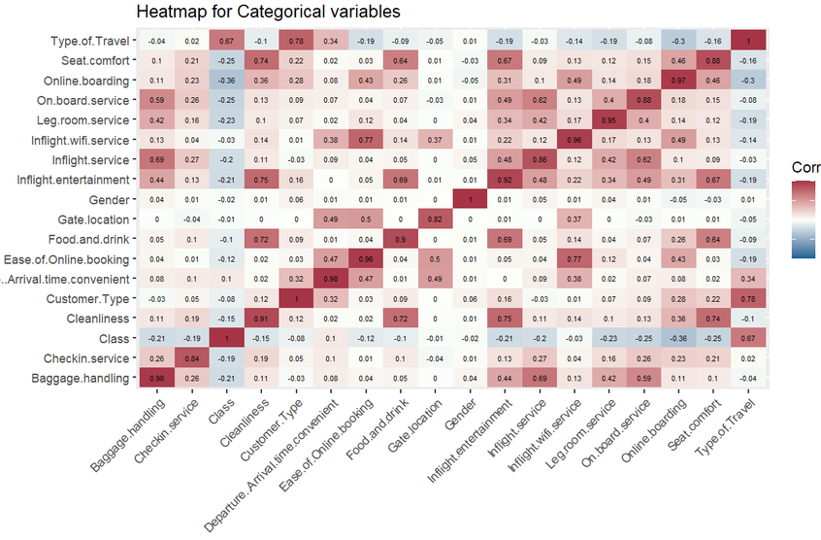
Correlations
Notes:
There are few correlations that don't make sense, like Inflight wifi service and ease of online booking, inflight entertainment and cleanliness. The other correlations make sense to some extent.

Slide 10
Modelling
Logistic Regression - Analysis of Distributions for possible transformations, Consider Regularization
Look at magnitude of coefficients
Compare results of transformed vs non-transformed data
Run diagnostics
Apply transformations as needed
Random Forest
Discover relative feature importance.
Support Vector Machines
Analysis of Distributions for possible transformations, Center and Scale Data, Optimal Choice of Kernel, Optimal Value of C/lambda.
The models will be compared using ROC-AUC on a reserved validation set.

Slide 11
Other Datasets and Research Findings
Pereira et al. (2023) provided an exhaustive and updated literature review about airlines’ passenger satisfaction while analyzing the most influential factors on satisfaction before and during the COVID-19 pandemic.³
Lucini et al. (2020) found practical implications to maximize customer satisfaction: focus on customer service for first class passengers, comfort for premium economy passengers, and checking luggage and waiting time for economy class travelers.⁴
Morgeson et al. (2023) focused on the American Customer Satisfaction Index (ACSI) and helped us better explore and analyze it.⁵
ACSI Dataset seems to contradict some of the findings from the primary dataset³
Notes:
Age and Gender P values were 0.618 and 0.231 respecitvely in the ACSI, contradicting the Logistic Regression model on Kaggle data
Cleanliness requirements changed after COVID.

Slide 12
Sources
https://www.forbes.com/sites/forbesbusinesscouncil/2022/12/12/customer-retention-versus-customer-acquisition/?sh=3cef46fc1c7d
https://www.kaggle.com/datasets/teejmahal20/airline-passenger-satisfaction
https://www.sciencedirect.com/science/article/pii/S0969699723000844#bib20
https://www.sciencedirect.com/science/article/abs/pii/S0969699719302959
https://www.sciencedirect.com/science/article/pii/S2352340923002421
https://psycnet.apa.org/record/1989-10632-001
https://www.techscience.com/cmc/v75n1/51460/pdf

Slide 13
Project Requirements Delete once done
What to Include & What is Required?
4-5 minutes of video/audio content that presents your group’s project proposal
Team members' names should be listed in the presentation.
Speaker should mention who they are before speaking – during video
Necessary background information/framing of the problem.
Include an overview of the problem in general as well as your planned approach (it is ok if this approach changes later in the project as you learn more information)
Any initial hypotheses?
What type of models do you plan to use?
How has your data cleaning progressed?
If you encounter any unexpected problems, challenges, or interesting findings please mention these. Discussion of things that didn’t work is also encouraged.
You could include things like any new datasets that you have found, any analysis that you have done on the datasets, or any other impactful and measurable progress that you have made thus far.
The team should review 2-3 research articles/papers/Kaggle kernels/ etc. related to your problem statement and then discuss them.. Be sure to cite the reference at the end of the slide show or visual medium.
If you have any graphs or key visuals to include, be sure to add titles, captions, labels, axes, legends, and most importantly context where necessary!
Visuals and Slides are necessary; DO NOT just read your written project proposal
Include audio narration
We do not require all group members to be part of the video given the limited time allocated
Sources cited on the last slide (no need to read them just include them).
4-5 minutes is a limited time window to cover all these things but do your best to manage this time wisely and play to your strengths and present a clear idea of your project

